Slide 1
Predicting Loan Acceptance for Galaxy Bank
Presented by Rigat David Mahanan | February,2025

Slide 2
Problem Statement
Objective:
Enhance marketing conversion rates by predicting which deposit customers will accept personal loans.
Context:
Last year's campaign achieved >9% conversion; aim to improve with minimal budget.

Slide 3
Data Overview
Dataset:
5,000 customers, 13 features (e.g Income, Education, CCAvg), Personal Loan target (0/1).
Key Stat:
9% loan acceptance rate (e.g., 480/5,000 from value_counts).

Slide 4
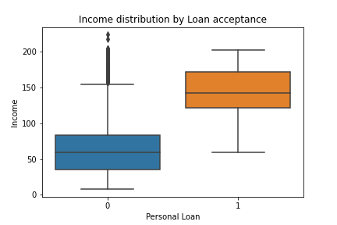
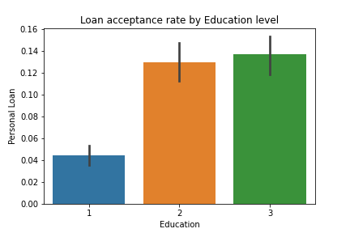
Data Exploration Insights
Higher income among loan acceptors
Acceptance rate rises with education level

Slide 5
Model Building
Approach:
Multi-variable linear regression on scaled features
Process:
70/30 train-test split, standardized features, trained model.

Slide 6
Model Evaluation
Regression Metrics:
Mean Squared Error (MSE): 0.0554
R-squared (R²): 0.4091
Insight:
Model explains 41% of variance in loan acceptance likelihood.
Classification Metrics(Reference, Threshold = 0.5):
Accuracy: 93% (93% of predictions correct, note class imbalance).
For Loan Acceptors (Class 1):
Precision: 89% (89% of predicted acceptors were correct).
Recall: 32% (32% of actual acceptors were identified).
F1-score: 48% (balanced measure, indicates room for improvement).

Slide 7
Feature Importance
Coefficients:
Top Positive: Income (0.1348), Experience (0.0856), CD Account (0.0754).
Negative: Age (-0.0785), CreditCard (-0.0216), Securities Account (-0.0195).

Slide 8
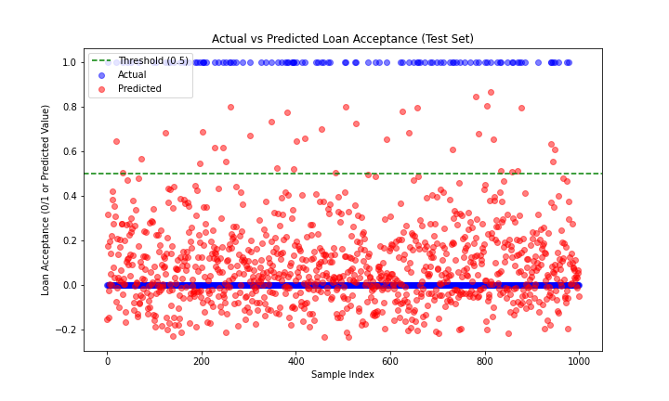
Business Impact
Result: Acceptance rate in top 10% predicted: 74.00%.
Lift: From 9% baseline to 74%, an 8.2x increase.
ROI: Dramatic improvement in conversions with same budget by targeting top prospects.

Slide 9
Risks, Limitations, and Notes
Risks:
Continuous predictions may cause the model's predictions to be too high or too low (e.g., numbers greater than 1 or less than 0).
It assumes past customer behavior will stay the same in the future.
Solutions:
Check the model with new campaign results.
Try using a different model, like logistic regression, for better results in the future
Notes:
I used a multi-linear regression model to predict how likely customers are to take a loan.
Normally, a logistic regression model would work better for yes/no answers like this. I picked the linear model because that’s what the project asked for.
The model could be made better by fine-tuning it, testing it more ways, or improving the data we use.
The model isn’t great at finding customers who will accept loans—it only catches 32% of them. This means we might miss a lot of potential loan takers, which could lower our success rate unless we change how we target them, like lowering the cutoff point or switching to logistic regression.

Slide 10
Recommendations
Implementation:
Deploy model to score customers, target top 10% in real-time.
Next Steps:
Start a small test campaign, keep an eye on the big improvement (8.2 times more conversions than before), and make the model better over time.
The code for this model is fully prepared and ready for DevOps deployment.

